Slide 1
Application Layer

Slide 2
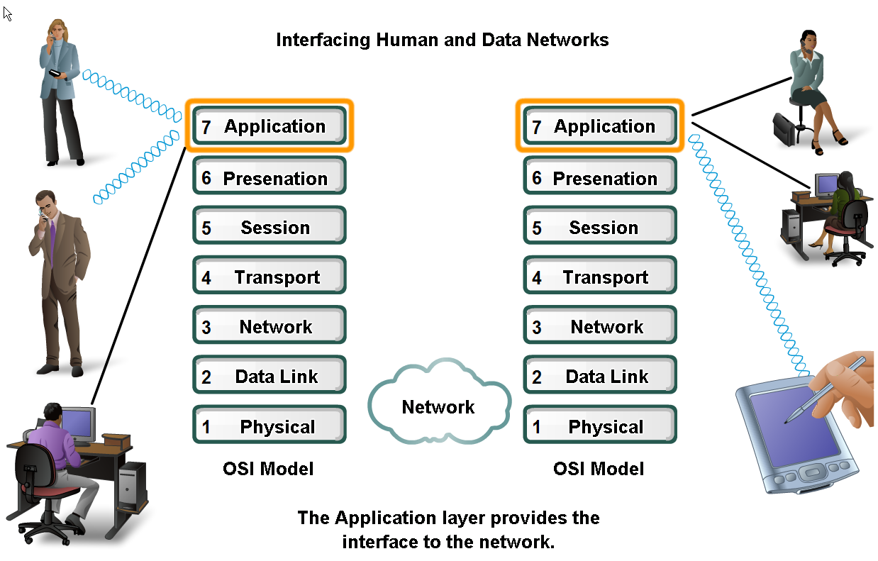
Application Layer
The application layer enables the user, whether human or software, to access the network.
It provides user interfaces and support for services such as electronic mail, file access and transfer, access to system resources, surfing the world wide web, and network management.

Slide 3
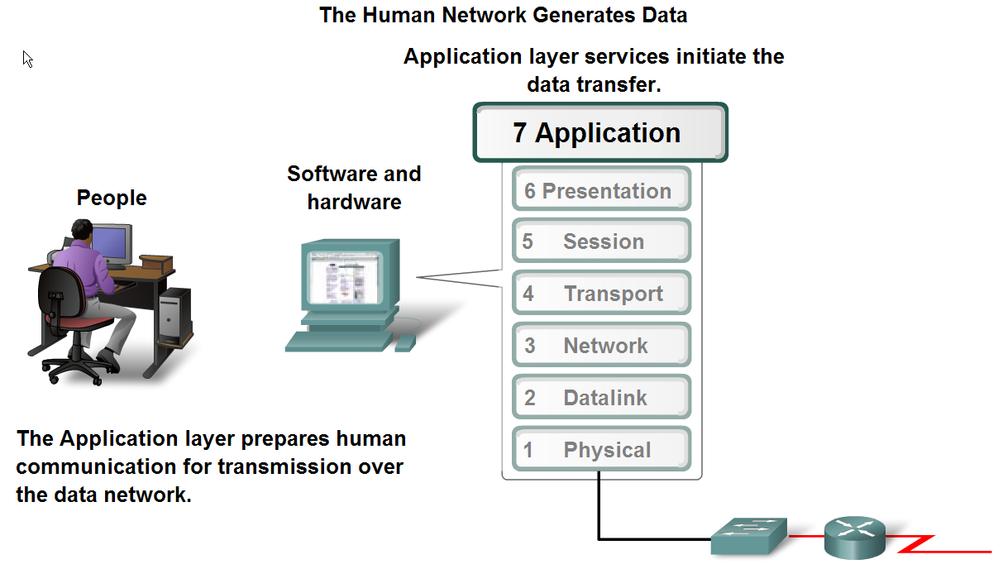
The role of applications, services and protocols in converting communication to data that can be transferred across the data network

Slide 4
There are several applications in the application layer of the Internet model that follow the client/server paradigm.
The client/server programs can be divided into two categories:
  Those that can be directly used by the user, such as e-mail,
  Those that support other application programs. The Domain Name System (DNS) is a supporting program that is used by other programs such as e-mail.

Slide 5
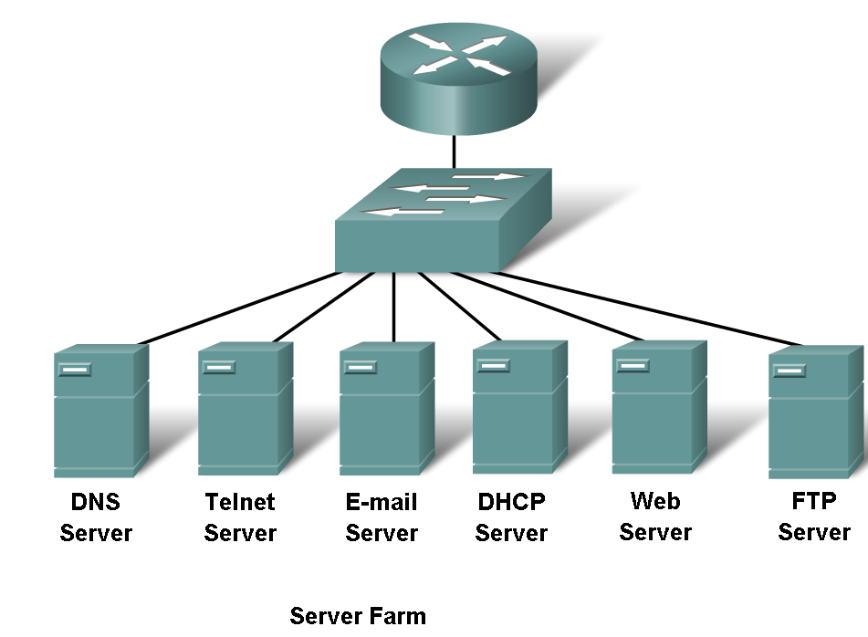

Slide 6
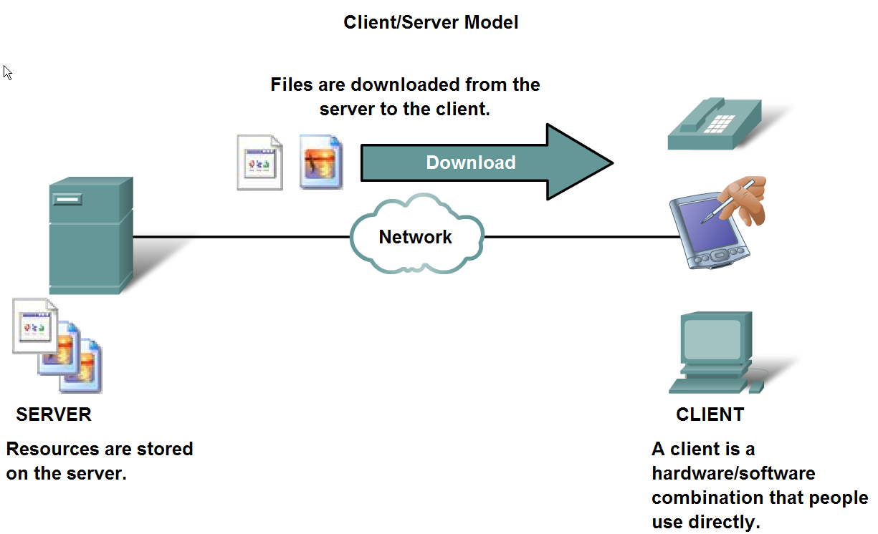
Roles of client and server processes in data networks
In the client/server model, the device requesting the information is called a client and the device responding to the request is called a server.
Client and server processes are considered to be in the Application layer.
Application layer protocols describe the format of the requests and responses between clients and servers.

Slide 7
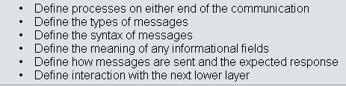
Common Application Layers services and protocols
Application layer protocols are used by both the source and destination devices during a communication session.

Slide 8
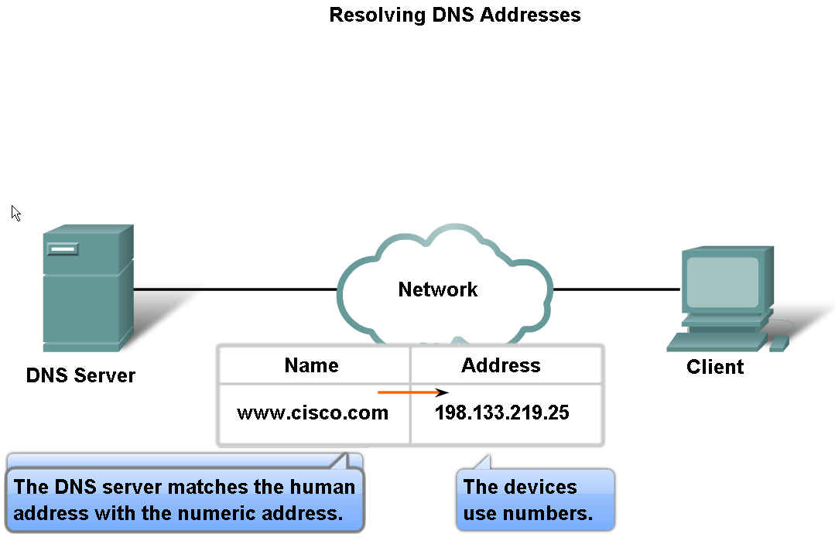
Features of the DNS protocol and how this protocol supports DNS services

Slide 9
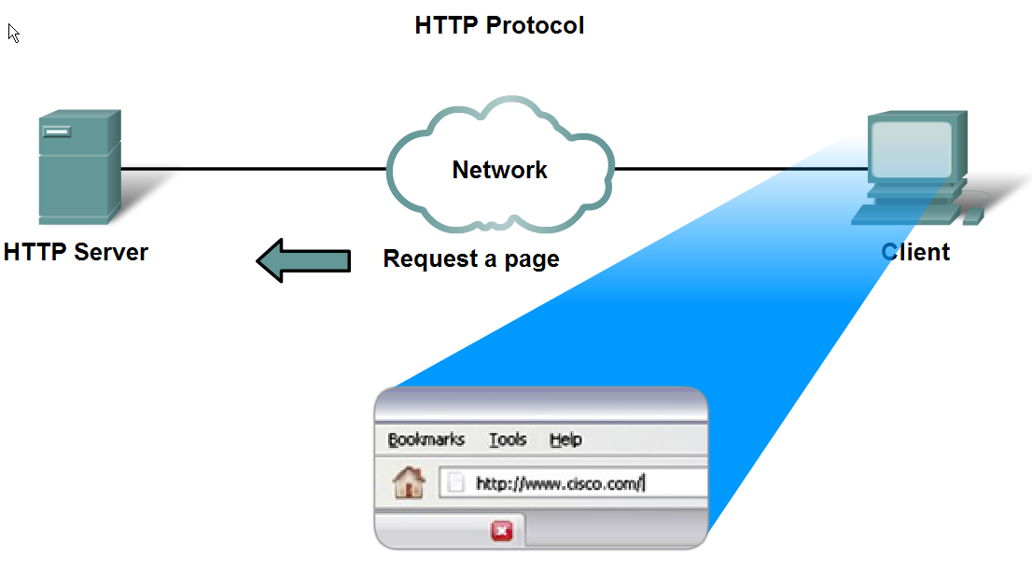
Features of the HTTP protocol and how this protocol supports the delivery of web pages to the client
GET – Client Request For Data
PUT & POST – Upload the data to the web server

Slide 10
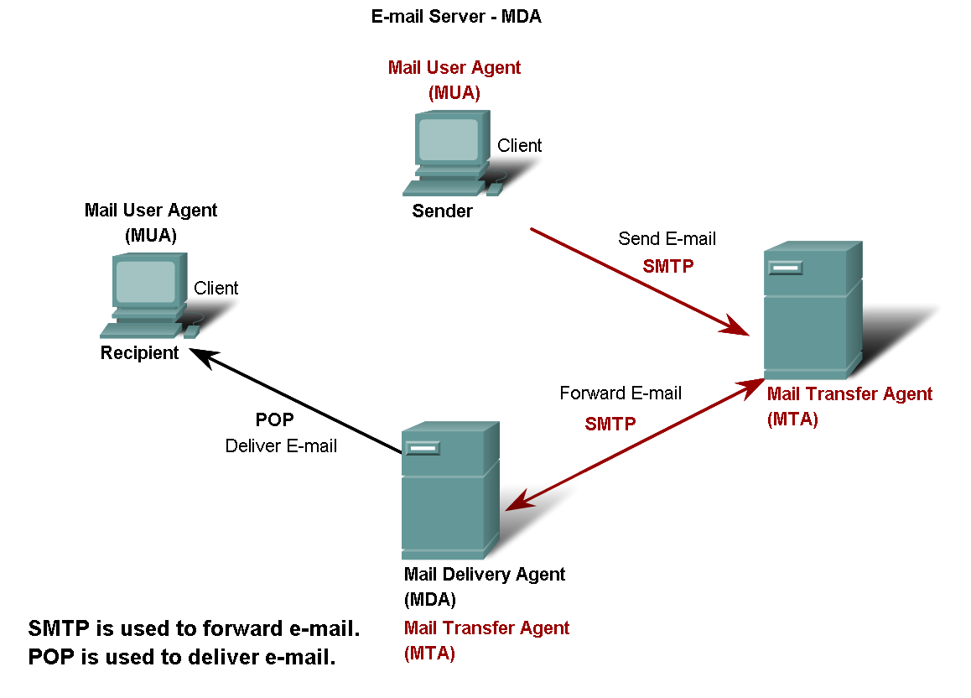
E-Mail Server
Features of the POP and SMTP protocols, and how these protocols support e-mail services

Slide 11
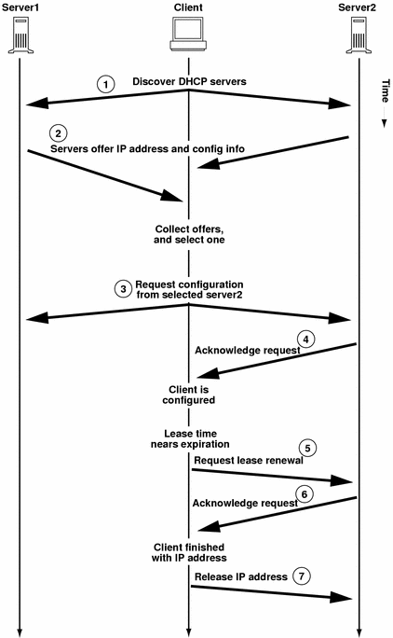
DHCP Server

